Slide 1
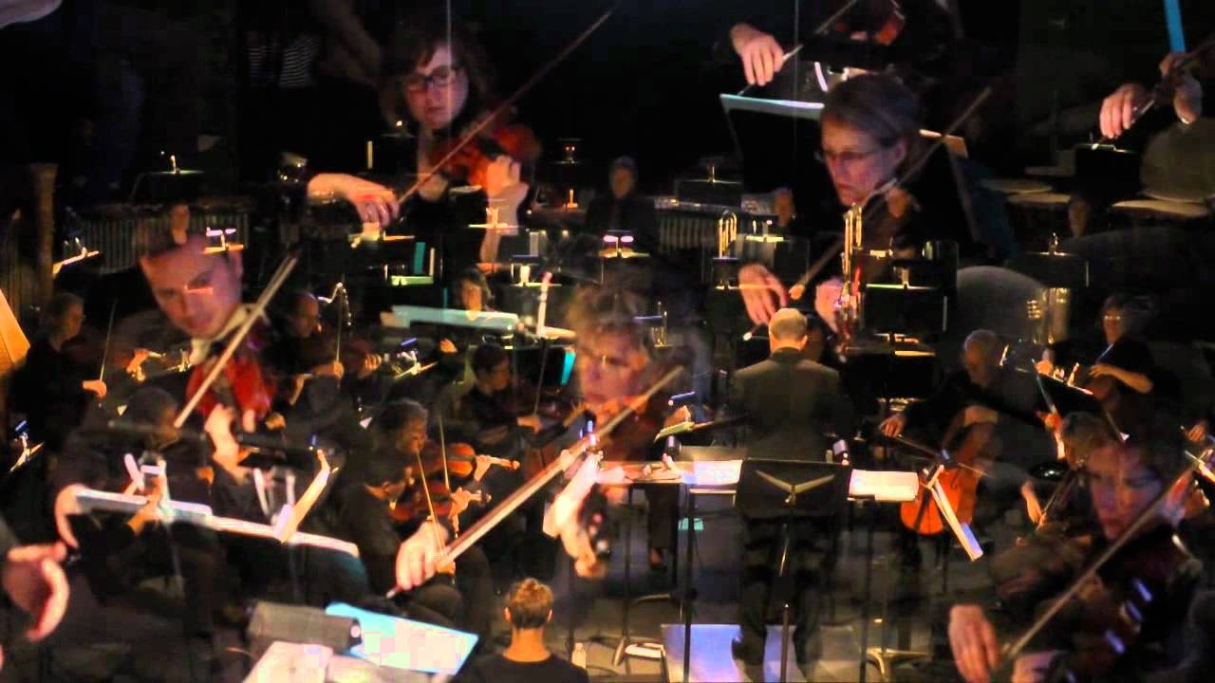
QUANTUM COMPUTER MUSIC
Source : Institute for Quantum Computing(yt channel)
Team Members
Devanshu Garg, IIT Kharagpur
Sai Nandan, Electrical Engineering, Karunya University
Sai Rupa, Guru Nanak Institute Technical Campus
Samuel Zahorec, Institute of Particle and Nuclear Physics, Charles University Shreya Satsangi, Dayalbagh Educational Institute

Slide 2
Background :
The first uses of computers in music were for composition. The great majority of computer music pioneers were composers interested in inventing new music and/or innovative approaches to compose. They focused on developing algorithms to generate music.
Hence the term ‘algorithmic computer music’. Essentially, the art of algorithmic computer music consists of :
(a) harnessing algorithms to produce patterns of data and (b) developing ways to translate
These patterns into musical notes or synthesised sound.
https://arxiv.org/pdf/2110.12408.pdf [1]
Nowadays, computing technology is omnipresent in almost every aspect of music. Therefore, forthcoming alternative computing technology, such as biocomputing and quantum computing will certainly have an impact in the way in which we create and distribute music in time to come. [1]
Our project is an introduction to the pioneering research into the exploration of emerging field of quantum computing technology in music
https://stoneyroads.com/2016/09/listen-to- the-first-recorded-piece-of-computer- generated-music/
Here is the audio of the first ever music produced by using computer.
https://soundcloud.com/guardianaustralia/first-ever-recording-of-computer-music? utm_source=stoneyroads.com&utm_campaign=wtshare&utm_medium=widget&utm_content=https%253A%252F%252Fsoundcloud.com
%252Fguardianaustralia%252Ffirst-ever-recording-of-computer-music

Slide 3
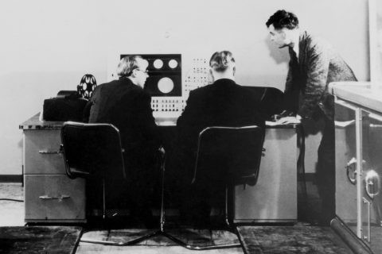
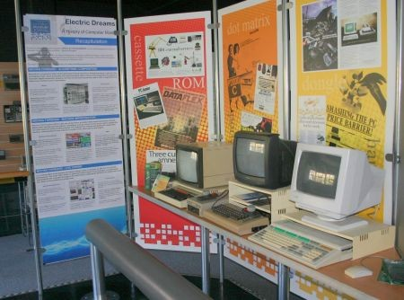
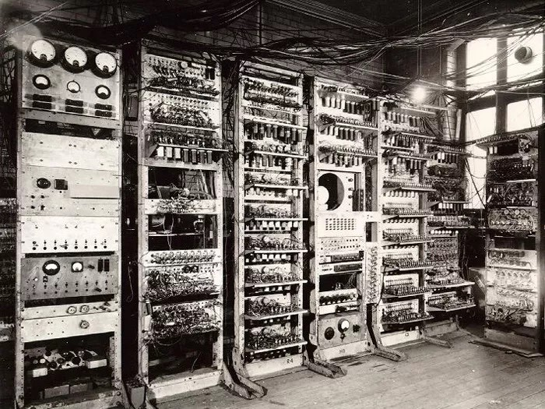
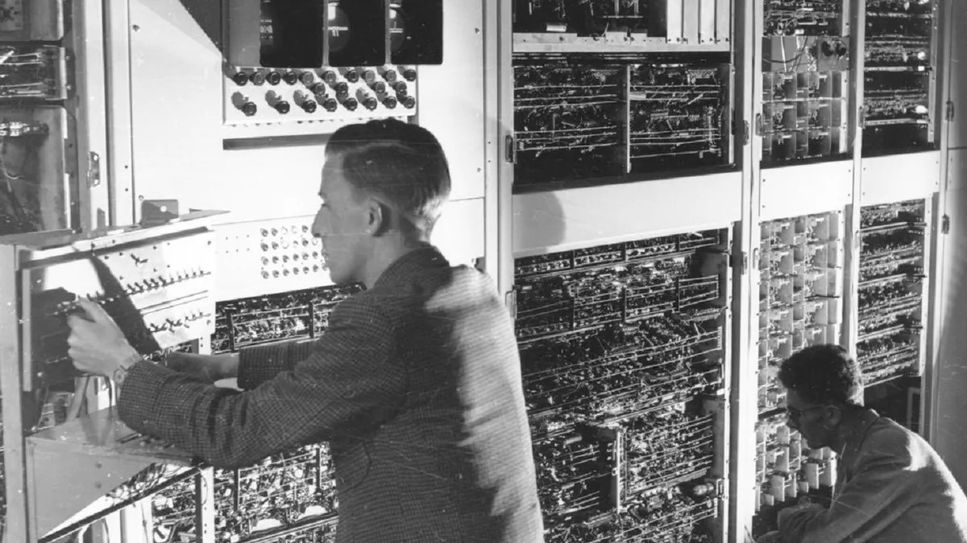
Visitors can have hands-on experience with music software on 1980s desktop computers
at the exhibition
(https://ajovomultja.hu/ news/history-computer- music?language=en)
https://stoneyroads.com/2016/09/listen-to-the-first-recorded- piece-of-computer-generated-music/
CSIRAC was the first computer to play music in the 1950s
'The Baby' was the forerunner to the Ferranti Mark 1 that was used to make the first computer music recording.
https://www.musicradar.com/news/tech/a-brief-history-of-computer-music-177299

Slide 4
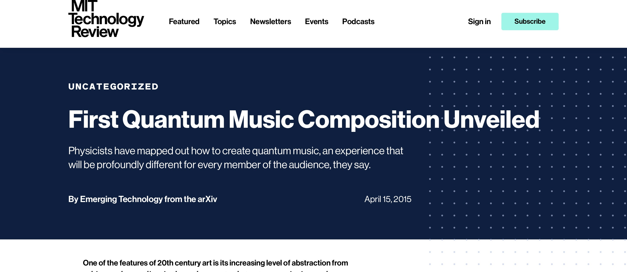
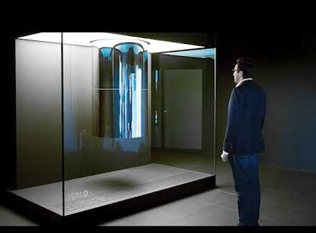
Current Work in Quantum Computer Music
Currently people around globe are working in the field of quantum music, some of the recent work in this field are given :
1. First Quantum Music Composition Unveiled
In 2015, this article suggested that we can think the seven notes in a quantum octave as independent event. They also suggested that an audience will hear the same sequence of notes but when a quantum musical state is observed, it will collapse into any one of the notes. The notes will be formed entirely random, but it will depend on the precise linear
setup of the state
(https://www.technologyreview.com/2015/04/15/168638/first-quantum-music-composition-unveiled/)
2. Hear Musicians Jam With a Quantum Computer
In this article, Dr Alexis Kirke, Senior Research Fellow in the Interdisciplinary Centre for Computer Music Research at the University of Plymouth (UK), has been able to show that a human musician can communicate directly with a quantum computer via teleportation, through which a blend of live human and computer-generated sounds could come together to create an unique performance piece.
https://www.technologynetworks.com/ informatics/news/hear-musicians-jam-with- a-quantum-computer-336979
2.

Slide 5
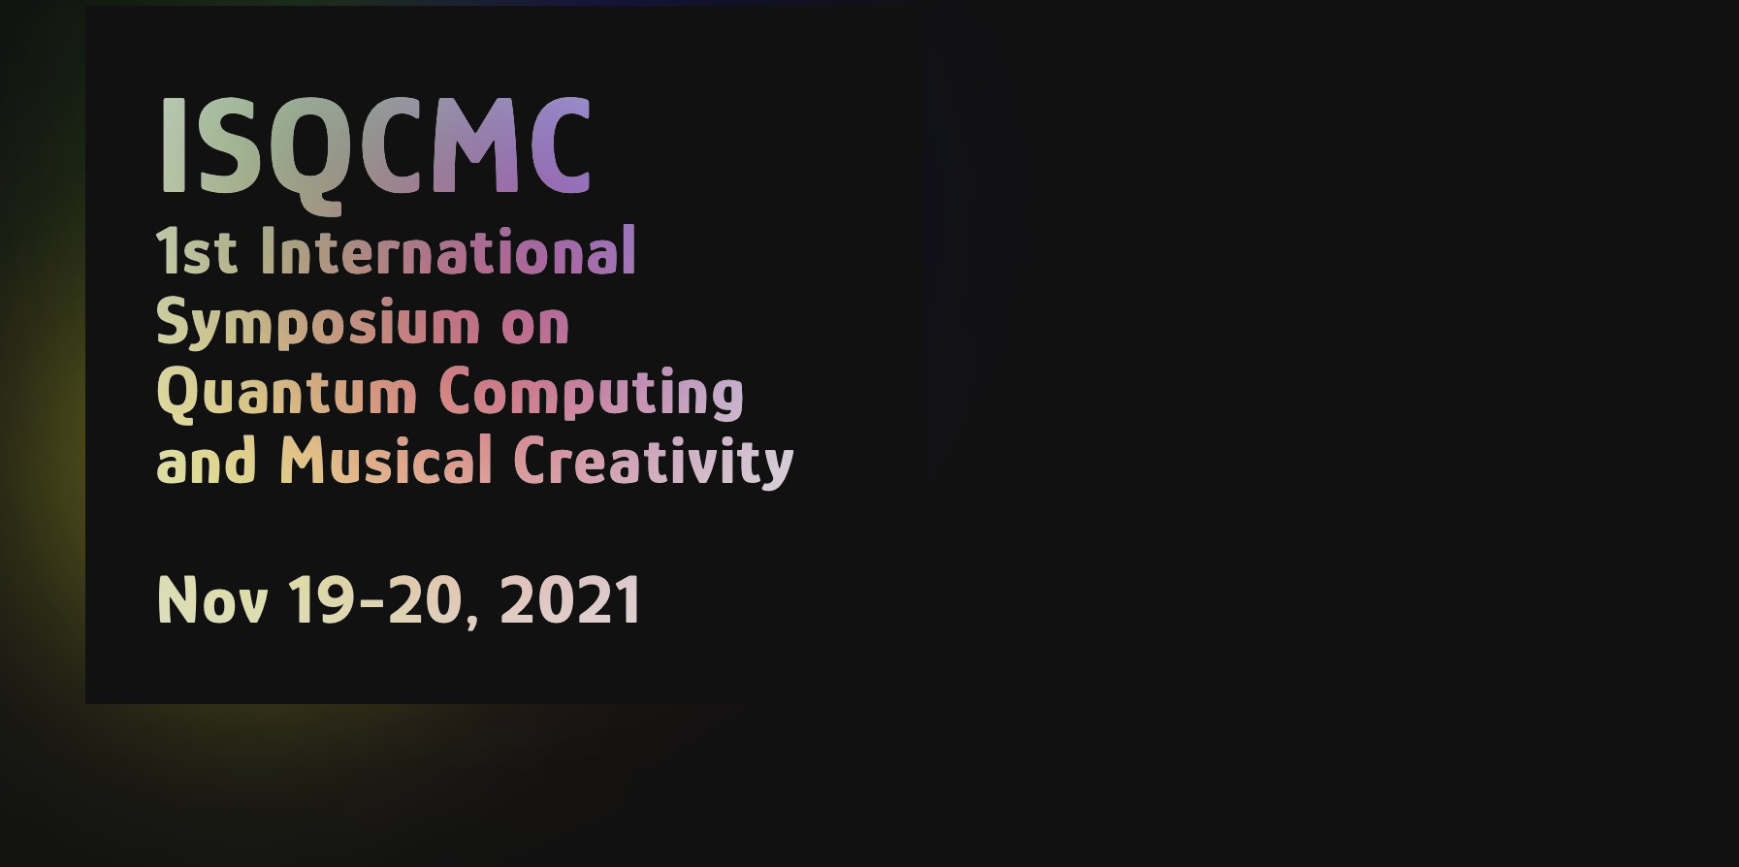
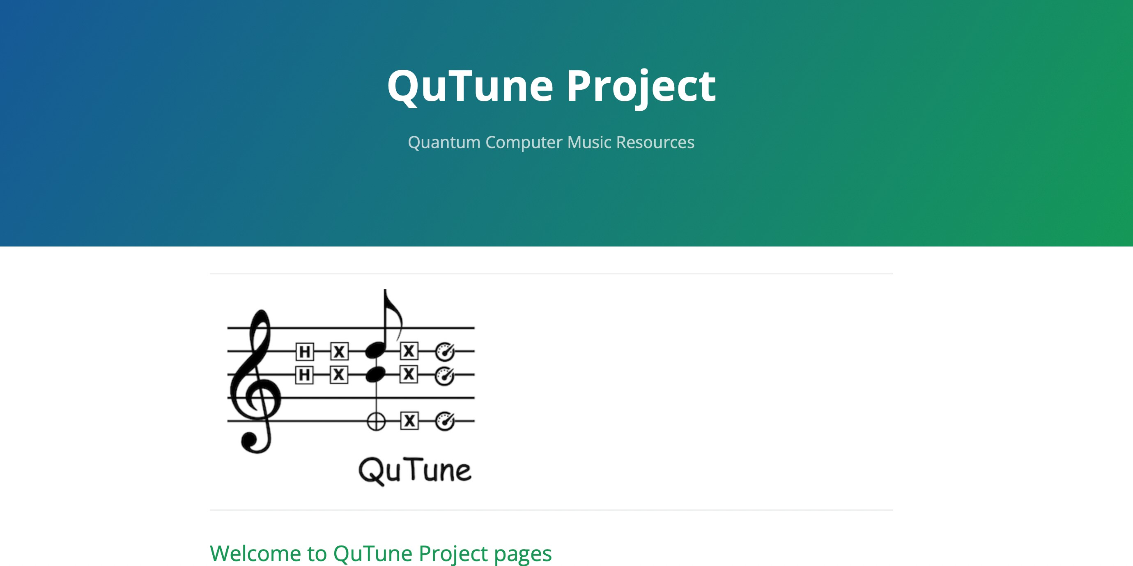
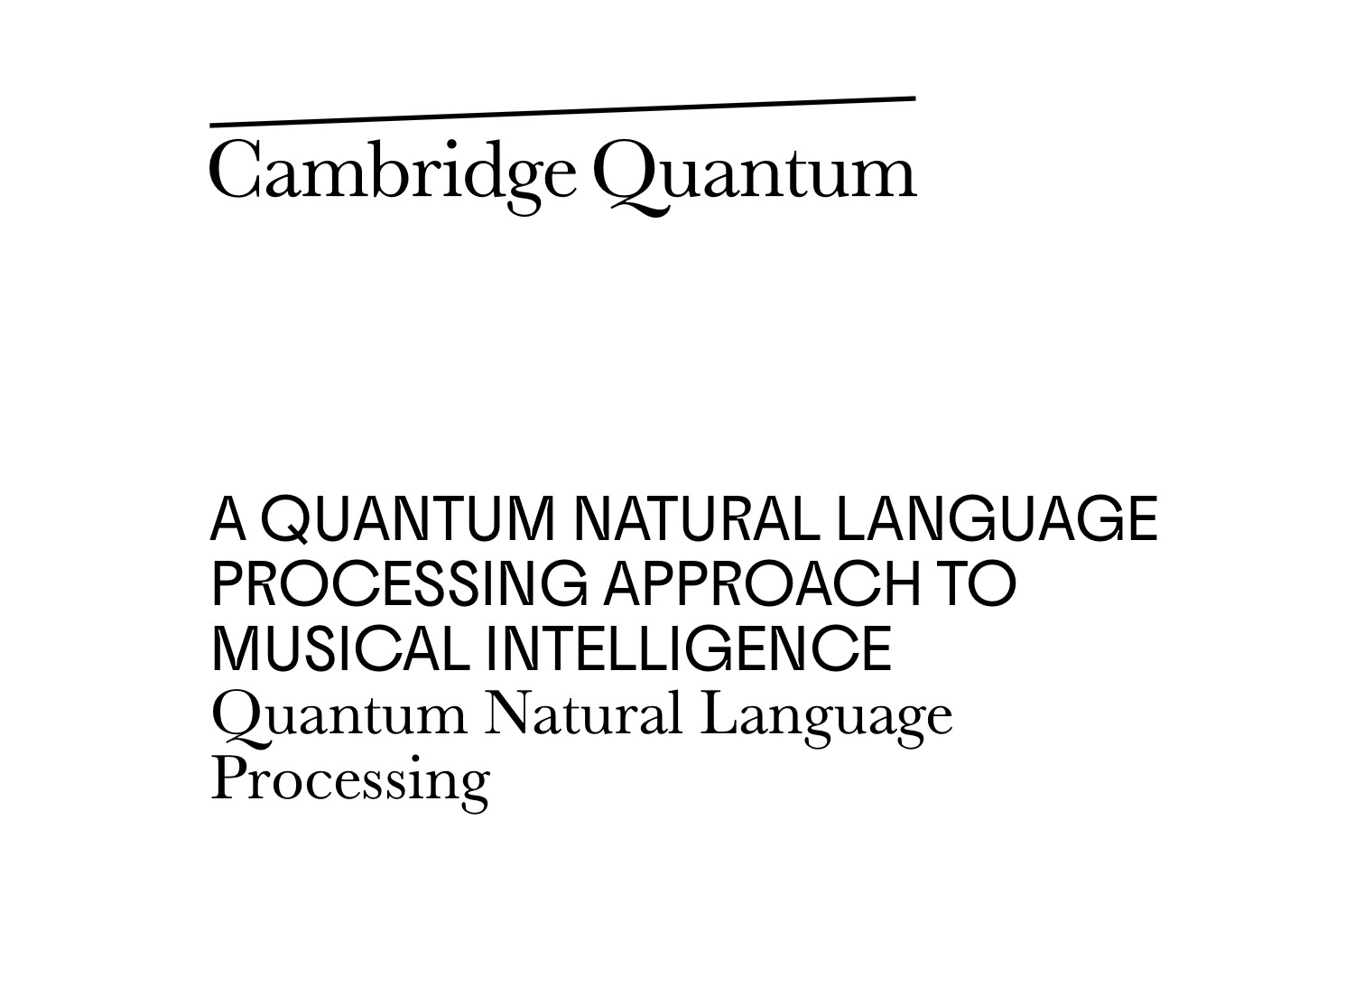
3. QuTune Project
Currently QuTune is the leading team of scientists/researchers/musicians, which are working together to enhance the field of Quantum Music. They recently organised the 1st International Symposium on Quantum Computing and Musical Creativity. They have around 5 research papers published in this field and around 3 articles on the topic. Medium is an American online publishing platform, and that has published around 3 articles on Quantum Music.
(https://iccmr-quantum.github.io)
4. A QUANTUM NATURAL LANGUAGE PROCESSING APPROACH TO MUSICAL INTELLIGENCE
In this project, researchers are trying to make an intelligent music system, where the system will know what to play in different occasions. A challenging task is to design generative systems with enough knowledge of musical structure and ability to manipulate said structure, so that given requests for mood, purpose, style, and so on, are appropriately met.
(https://cambridgequantum.com/a-quantum-natural-language-processing-approach-to-musical-intelligence/)

Slide 6
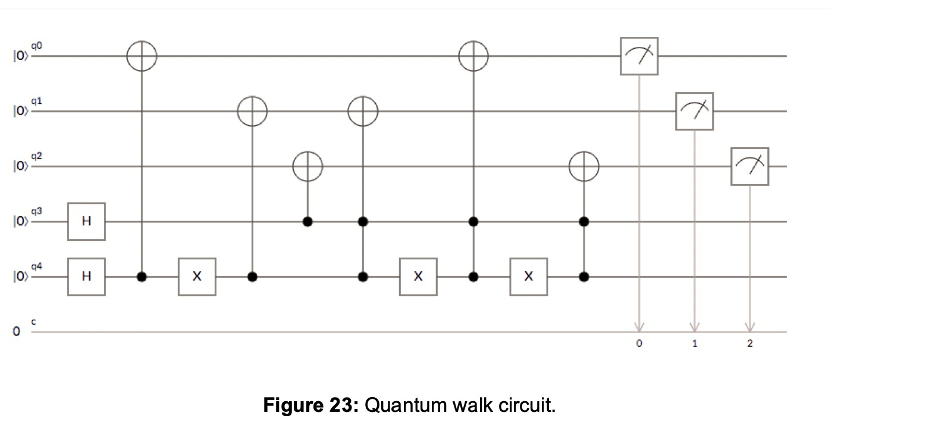
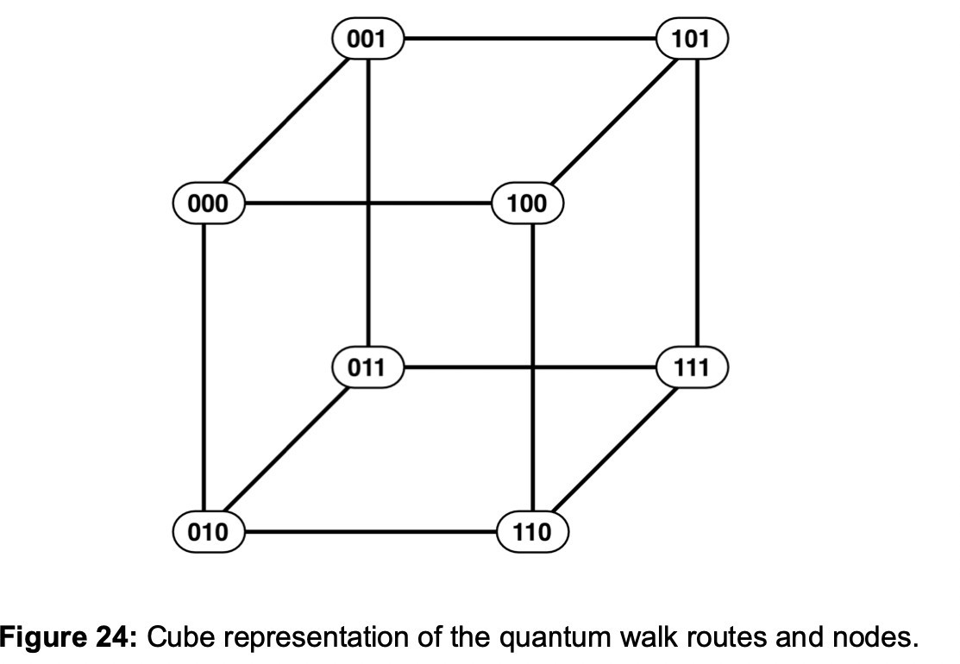
Our project
In our Quantum music project, we have used random walk on a cube to make a quantum circuit using jupyter notebook and python language and the outputs were converted to notes and rhythms by simply running the quantum circuit. The corresponding notes and rhythms were used to create midi tracks by converting the outcome to the musical notations, and now once we have our music notation, we can play our quantum computer music anywhere anytime. Simple steps that can be used to replicate our project,
Preparation of the quantum circuit [1]
[1]

Slide 7
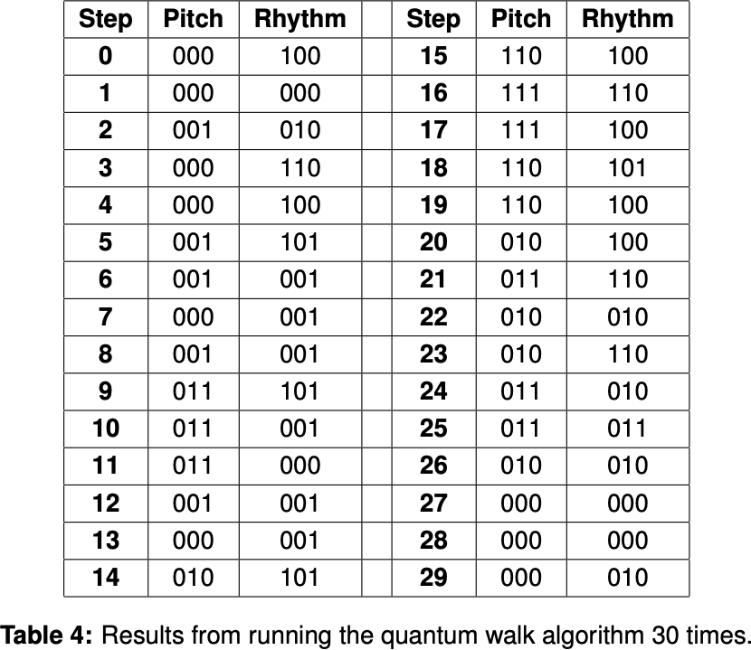
Creation of two lists, one for the pitch and the other one for the rhythm
For each list quantum circuit was iterated several times always beginning in the state where it was measured in the previous step
Conversion from binary outputs into notes (https://www.dcode.fr/music-sheet)
Creation of MIDI file
Reference : https://arxiv.org/pdf/2110.12408.pdf [1]

Slide 8
Future of quantum music
The Sound of the Future:
Technology has changed music forever and will continue to do so as long as it remains the part of human life. Even the way pop music sounds has been altered by the noises that computers generate, giving rise to the “electronic” genre. Tech’s effect on music will reverberate through the industry, revolutionising the balance between artists and powerful music labels. This opens the door for more niche, experimental music to reach the world. With the help of computers, social media and even AI, almost anything is possible in tomorrow’s music scene.The impact of quantum computer will be revolutionary and it will change the way we produced music before.
Music Driven by AI and Algorithm Technology:
A.I. is the ability of a computer to not only retain and regurgitate certain information, but to evolve, learn, and create new ways of interpreting and reciting information. The best comparison for this technology is the brain – a mechanism that can not only learn about its environment, but can learn about itself, and in turn begin to learn in new ways an A.I. includes algorithms but also implements general reasoning, and self-correction or adaption mechanisms. Although A.I. is still in its initial stages, once it becomes fully developed, there is no telling how capable a technology it will become. AI/ML will bring quantum music to the new height, and improve our way of understanding of music.

Slide 9
Current Work
The system qgMuse lays some groundwork for new ways of addressing a significant problem in computer music research, unstructured random search for desired music features.
Projects like Quantum Music(http://quantummusic.org) are bringing scientists/researchers/ musicians together to work on Quantum Music.
Next Steps Of Our Project :
For the next part of the project we would like to implement complex random walk.
The final aim would be to generate whole arrangement of an Orchestra by using different instruments.
This would be possible by a website or a python library where music enthusiasts can play around with different arrangements.
Using continuous variable quantum programming we would like to represent the string based instruments more accurately.

Slide 10
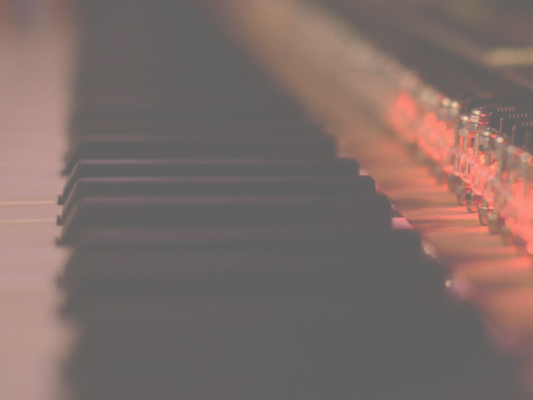

THANK YOU
Find us on …….
Team Members
Devanshu Garg
Sai Nandan
Rupa
Samuel Zahorec
Shreya Satsangi

